Slide 1
MAHATMA GHANDI

Slide 2
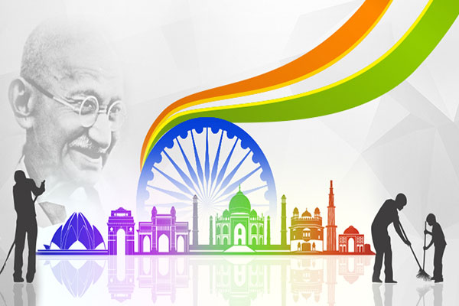
GANDHI
Mohandas Karamchad Gandhi was born on 2 october 1869 in Porbandal, a coastal town in the state of Gujarat,in India

Slide 3
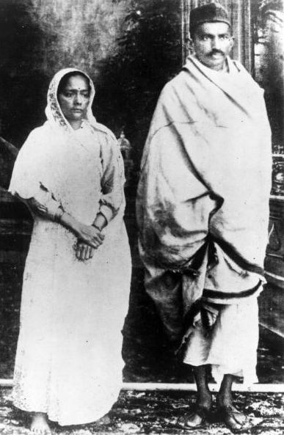
THE FIRST YEARS OF HIS LIFE
At the age of thirteen he was married to Kasturba and they had four sons. The marriage had been arranged for him by his family. On 4th september 1888 he traveled to London.
He studied law and became a lawyer. After taking his degree in Law, in 1891 he returned to India and in 1893 he started working as a lawyer in South Africa. As soon as he arrived there, he was shocked at the treatment of Indian immigrants by the British (South Africa was part of the British Empire).

Slide 4
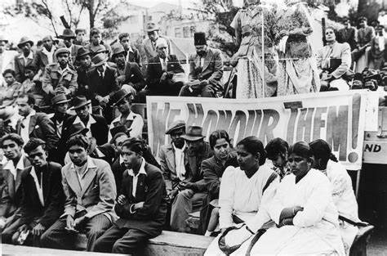
IN SOUTH AFRICA
His experience of racism in South Africa proved to be a turning point in his life. He was refused admission to hotels, he was beaten up when he refused to give up his seat to a white man on a stage coach in Johannesburg and he was thrown off a train when he refused to move to a third class compartment, after he had paid for a first class ticket. When he was about to return to India, he heard that a law was going to be passed to prevent Indian people from voting. He decided to draw attention to this injustice and became an activist.

Slide 5
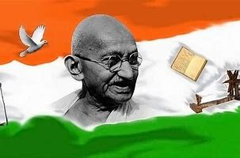
THE RETURN TO INDIA
In 1915 Ghandhi returned to India and parteciped in The First World War as a male nurse. In 1919 he became the proponent of independence. In 1930 began the campaign of disobedience against the tax salt. With the salt march Mahatma walked 400 kilometeres on foot to the sea for the purpose of taking a few grains of salt ,in violation of the British law which imposed the state monopoly on this precious food. It Was a simple non- violent act,which didn’t cause any damage to the state either but for this very reason he stressed the absurdity of a law and the disproportion between its violation and the sentence inflicted. After this episode the campaign expanded: boycott of fabrics from abroad(waving their clothes became a symbolic act of disobedience)isolation of government officials to which traders refused the goods.He sopke also in a National Congress but was primarily introduced to Indian issues, politics and the Indian people by Gopal Krishna Gokhale, a respected leader of the congress party at the time.

Slide 6
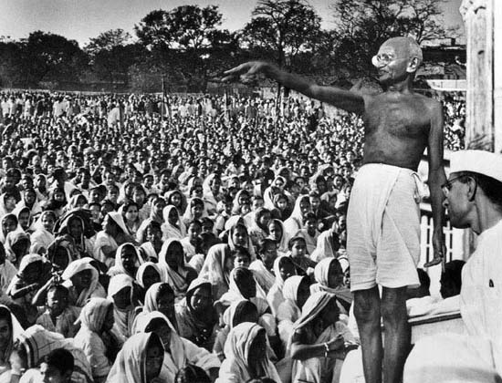
GANDHI TAKES A LEADER SHIP ROLE

Slide 7
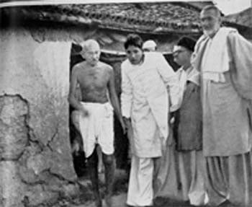
ROLE IN THE FIRST WORLD WAR
In April 1918, during the latter part of the First World War, Gandhi was invited by the Viceroy to a war Conference in Delhi. Perhaps to show his support for the Empire and help his case for India’s indipendence, Gandhi agreed to actively recruit Indians for the war effort. In contrast to the Zulu war of 1906 and the outbreak of the first world war in 1914, when he recrutited volunteers for the Ambulance Corps, this time Gandhi attempeted to recruit combatans.

Slide 8
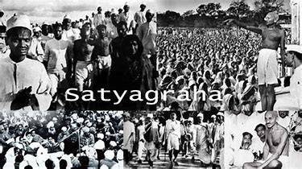
SATYAGRAHA AND A POLICY OF NON-VIOLENCE
In 1918, in Champaran, a discrit in the state of Bihar, tens of tousands of landless serfs, indurated labores and poor farmers were forced to grow indigo and other cash crops instead of a food crops necessary for their survival.Gandhi proposed SATYAGRAHA-NON-VIOLENCE, Gandhi was proposing a real action, a real revolt that the oppressed people of India were dying to undertake. His main assault came as he was arrested by police. Hundreds of thousands of people protested and rallied outside the jail

Slide 9
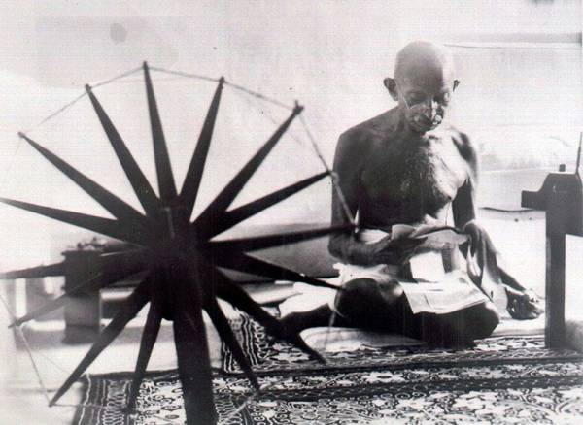
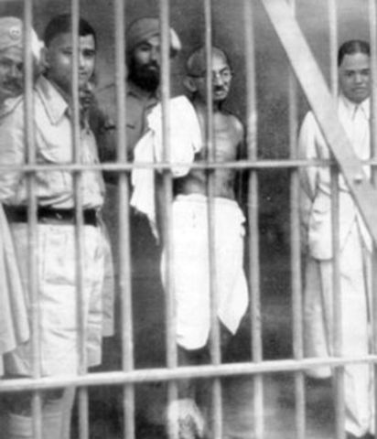
IMPRISONMENT
Gandhi employed non-cooperation, non-violence and peaceful resistance as his «weapons» in the struggle against British. Gandhi criticized both the actions of the British Raj and the retaliatory violence of Indians.When he was arrested he continued his non-violence protest through hunger strikes. He was arrested on 10 March 1922,tried for sedition,and sentenced to six years’imprisonment . He began his sentence on 18 March 1922. He was released in February 1924. Without Gandhi’s uniting personality, the Indian National Congress began to splinter during his years in prison, spligging into two factions. Furthermore, cooperation among Hindus and Muslims, which had been strong at he height of the non-violence campaign, was breaking down. Gandhi attemped to bridge these differences through many means, including a three-week fast autumn of 1924, but with limited success.

Slide 10
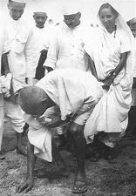
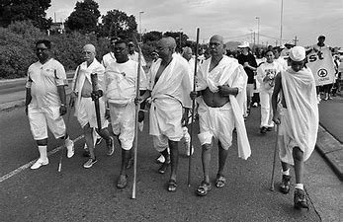
THE SALT MARCH
Starting in 1835,when provinces in India increasingy came under British ruke, the British imposed a tax on Indian salt and a series of salt laws. The salt laws made it illegal for Indians to collect, produce or sell salt. If someone broke the rules he was imprisoned for 6 months. Gandhi and many others found the opposition and the restrictions on salt production sunfair and decided to protest against them. For this,in 12th of Marh is started the SALT MARCH. Thousands of people from all over India joined the march to protest British rule. They walked about 12 miles a day and reached Dandi in three weeks. With the Dandi March, Gandhi launched the Civil Disobedience Movement against the British Empire. Following the Salt March, 80000 indians along with Gandhi were jailed. With this simple act of standing up against injustice, Gandhi shook the foundation of the British Empire in India. He showed that by working together, people of conviction and courage, even if each one is as small and powerless as a grain of salt, can make an enormous different.

Slide 11
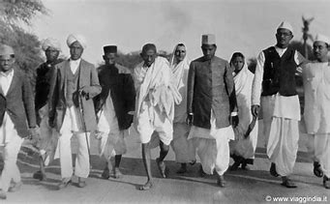
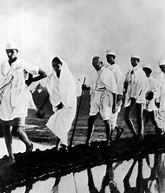
A DANGEROUS CAMPAIGN
This went on for hours until some 300 or more protesters had been beaten, many seriously injured and two killed. At no time did they offer any resistance.
This campaign was one of his most successful at upsetting British hold on India; Britain responded by imprisoning over 60,000 people. Congress estimates, however, put the figure at 90,000. Among them was one of Gandhi's lieutenants, Jawaharlal Nehru.
According to Sarma, Gandhi recruited women to participate in the salt tax campaigns and the boycott of foreign products, which gave many women a new self-confidence and dignity in the mainstream of Indian public life. However, other scholars such as Marilyn French state that Gandhi barred women from joining his civil disobedience movement because he feared he would be accused of using women as political shield. When women insisted that they join the movement and public demonstrations, according to Thapar-Bjorkert, Gandhi asked the volunteers to get permissions of their guardians and only those women who can arrange child-care should join him. Regardless of Gandhi's apprehensions and views, Indian women joined the Salt March by the thousands to defy the British salt taxes and monopoly on salt mining. After Gandhi's arrest, the women marched and picketed shops on their own, accepting violence and verbal abuse from British authorities for the cause in a manner Gandhi inspired.

Slide 12
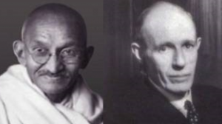
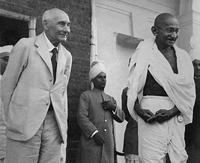
THE GANDHI-IRWIN PACT
The government, represented by Lord Irwin, decided to negotiate with Gandhi. The Gandhi–Irwin Pact was signed in March 1931. The British Government agreed to free all political prisoners, in return for the suspension of the civil disobedience movement. According to the pact, Gandhi was invited to attend the Round Table Conference in London for discussions and as the sole representative of the Indian National Congress. The conference was a disappointment to Gandhi and the nationalists. Gandhi expected to discuss India's independence, while the British side focused on the Indian princes and Indian minorities rather than on a transfer of power. Lord Irwin's successor, Lord Willingdon, took a hard line against India as an independent nation, began a new campaign of controlling and subduing the nationalist movement. Gandhi was again arrested, and the government tried and failed to negate his influence by completely isolating him from his followers.

Slide 13
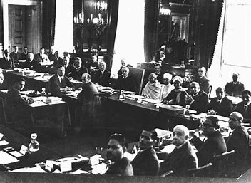
THE FIRST ROUND TABLE CONFERENCE
During the discussions between Gandhi and the British government over 1931–32 at the Round Table Conferences, Gandhi, now aged about 62, sought constitutional reforms as a preparation to the end of colonial British rule, and begin the self-rule by Indians. The British side sought reforms that would keep Indian subcontinent as a colony. The British negotiators proposed constitutional reforms on a British Dominion model that established separate electorates based on religious and social divisions. The British questioned the Congress party and Gandhi's authority to speak for all of India. They invited Indian religious leaders, such as Muslims and Sikhs, to press their demands along religious lines, as well as B. R. Ambedkar as the representative leader of the untouchables. Gandhi vehemently opposed a constitution that enshrined rights or representations based on communal divisions, because he feared that it would not bring people together but divide them, perpetuate their status and divert the attention from India's struggle to end the colonial rule.

Slide 14
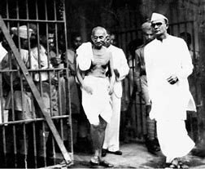
THE SECOND ROUND TABLE CONFERENCE AND THE IMPRISONMENT OF GANDHI
The Second Round Table conference was the only time he left India between 1914 and his death in 1948. He declined the government's offer of accommodation in an expensive West End hotel, preferring to stay in the East End, to live among working-class people, as he did in India. He based himself in a small cell-bedroom at Kingsley Hall for the three-month duration of his stayand was enthusiastically received by East Enders. During this time he renewed his links with the British vegetarian movement.
After Gandhi returned from the Second Round Table conference, he started a new satyagraha. He was arrested and imprisoned at the Yerwada Jail, Pune. While he was in prison, the British government enacted a new law that granted untouchables a separate electorate. It came to be known as the Communal Award. In protest, Gandhi started a fast-unto-death, while he was held in prison. The resulting public outcry forced the government, in consultations with Ambedkar, to replace the Communal Award with a compromise Poona Pact.

Slide 15
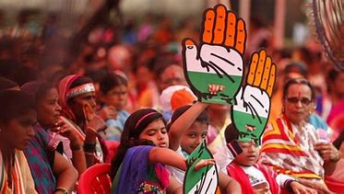
CONGRESS POLICTS
In 1934 Gandhi resigned from Congress party membership. He did not disagree with the party's position but felt that if he resigned, his popularity with Indians would cease to stifle the party's membership, which actually varied, including communists, socialists, trade unionists, students, religious conservatives, and those with pro-business convictions, and that these various voices would get a chance to make themselves heard. Gandhi also wanted to avoid being a target for Raj propaganda by leading a party that had temporarily accepted political accommodation with the Raj.
Gandhi returned to active politics again in 1936, with the Nehru presidency and the Lucknow session of the Congress. Although Gandhi wanted a total focus on the task of winning independence and not speculation about India's future, he did not restrain the Congress from adopting socialism as its goal. Gandhi had a clash with Subhas Chandra Bose, who had been elected president in 1938, and who had previously expressed a lack of faith in nonviolence as a means of protest. Despite Gandhi's opposition, Bose won a second term as Congress President, against Gandhi's nominee, Dr. Pattabhi Sitaramayya; but left the Congress when the All-India leaders resigned en masse in protest of his abandonment of the principles introduced by Gandhi. Gandhi declared that Sitaramayya's defeat was his defeat.

Slide 16
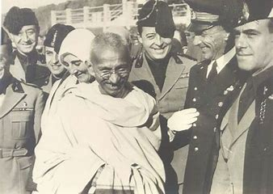
WORLD WAR II INTERRUPED THE INDEPENDENCE PROCESS
After long deliberations, Gandhi declared that India cuoldn’t be party to a war ostensibly being fought for democratic freedom, while that freedom was denied to India itself. As the war progressed Gandhi intensified his demand for indipendence, drafitng a resolution calling for the British to QUIT INDIA. This was Gandhi’s and the Congress Party’s most definitive revolt aimed at securing the British exit from India.

Slide 17
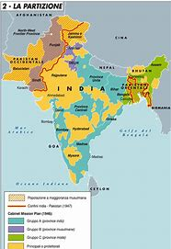
INDIA’S INDEPENDENCE
In 1947 finally Gandhi sees independence of India but Gandhi lives this great moment with pain. The great Indian nation wasn’t born,free and tolerant, units above caste and religious differences: two states emerged from the tormented political negotiations which preceded the 5th august, INDIA and PAKISTAN with the creation of which the difference between HINDU and MUSLIN has been sanctioned. The struggles that soon arose between MUSLISMS and HINDUS had him as a peacemaker but extremist elements there were a part of a plot against the same GHANDI who was killed in revolver by an orthodox hindu fanatic

Slide 18
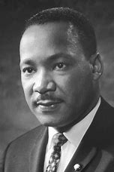
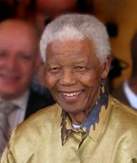
GHANDI HAS ISPIRED
MARTIN LUTHER KING
NELSON MANDELA

Slide 19
GANDHI’S THINKING IS BASED ON THREE FUNDAMENTAL POINTS
SELF-DETERMINACION OF PEOPLES
NON-VIOLENCE
RELIGIOUS TOLERANCE

Slide 20
Gandhi considered it essential that the Indians could decide how to govern their country because the misery in which he stood depended on the exploitation of resources by the British colonizers
SELFDETERMINATION OF PEOPLES
NON-VIOLENCE
Is it necessary to specity that this precept doesn’t stop at a negative position but possesses in itself the positive charge of universal benevolence and becomes «pure love» commanded by the sacred texts of hinduism by the Gospels and the Coran
RELIGIOUS TOLERANCE
Gandhi dreams of peaceful and respectful coexIstence of The many ethnic group and religious professions present in India

Slide 21
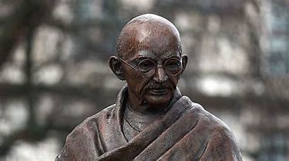
4 fundamental values for Gandhi in life
FEAR HUMILITY STRENGHT ENEMIES

Slide 22
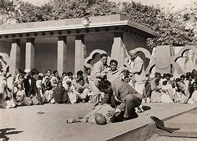
THE DEATH
Just over 70 years on january 30th,1948 Gandhi was killed in New Dheli. The great soul had already escaped an attack a few days before being killed. During the night a bomb exploded near his house while he was in a prayer meeting with other faithful and destroyed the wall overlooking the garden. On that occasion there was no further damage but the threat was clear. The bomber was a hindu escaped from Pakistan. A few days after the failed attack,Mahatma was hit by three deadly bullets two in the abdomen one in the chest.
Did in time only to say my god and found himself crouched on the grass in the arms of the nieces. He was brough into the house but a few minuts later a relative came out declaring the death. Gandhi’s death has left a great void his admirers remember him especially for his famous phrases and memorable quotes

Slide 23
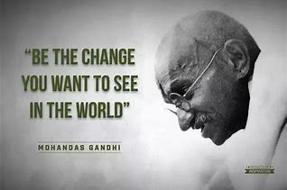

Slide 24
«BE THE CHANGE YOU WANT TO SEE IN THE WORLD» is the most famous sentence by Gandhi, through which he exhorts the world population to act, because thought alone,without action, is something destined to disappear, not to come true. I think that it is not enough to simply think about change, hope for change,but we must become in our life what we feel to be because whatever we do or say has a huge impact on all the people around as, and on return we receive a karmic effect in our life, this is the starting point of the lesson to wich Gandhi had arrived, change ourself to become what we want to be in our life experience. I decided to comment this quote because in our era we have a very diffrent vision of the world, convinced as we are that it would be better for us if those people out there changed, or that to live better it would be enough for people to change, but not ourselves, everyone considers himself perfect in his own way. I don’t agree because I believe that each of us can make a difference in the world, some in a small way and some in a big way you must just be yourself and I think that we can change the world by changing ourselves first. Another message that Gandhi wants to convey to us through this phrase is that changing means creating a positive difference, being aware that every day, that at any time, we have the opportunity to make a difference in another person’s life.

